Slide 1
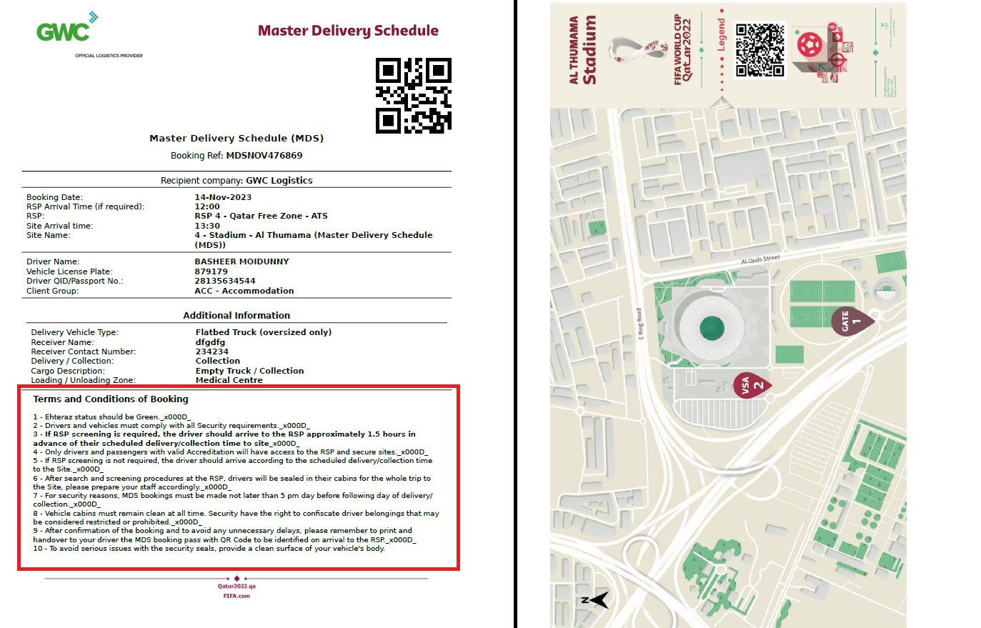

Slide 2

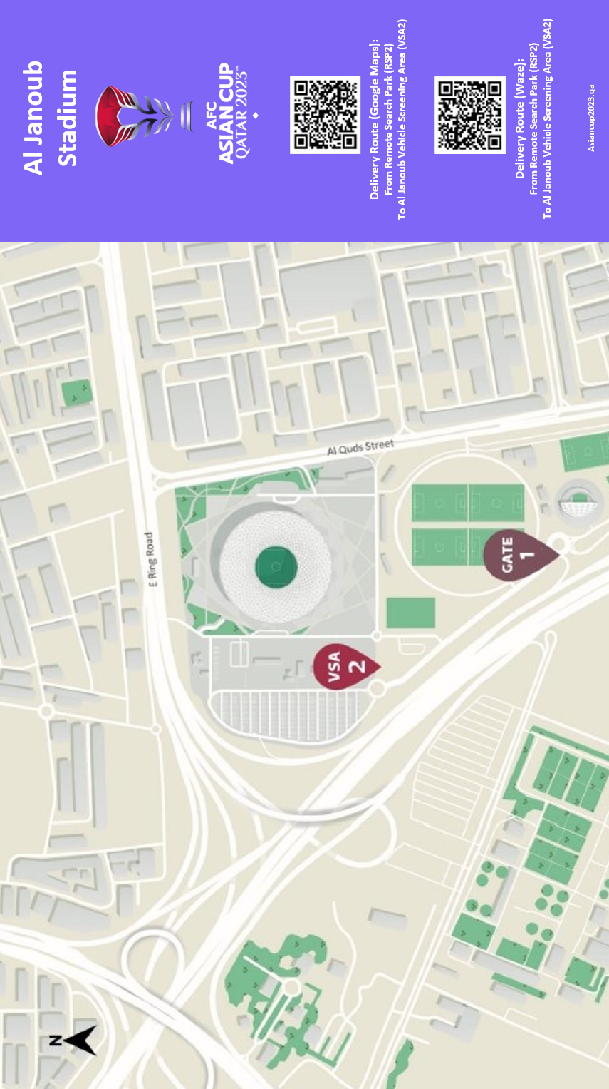
asiancup2023.qa

Slide 3


Al Janoub Stadium
Delivery Route (Google Maps):
From Remote Search Park (RSP2)
To Al Janoub Vehicle Screening Area (VSA2)
Delivery Route (Waze):
From Remote Search Park (RSP2)
To Al Janoub Vehicle Screening Area (VSA2)
asiancup2023.qa

